Slide 1


“The best guide to your future”
CitiVentures Innovation Challenge
Arsela | Ebin | Kylene | Ronak | Shirley | Susan | Tarini

Slide 2

Contents
Executive Summary
Vision
Pain Points
Solution
Product Mockup
Pros and Cons
Differentiation
Future Vision
Roadmap

Slide 3

Home
Contents
Executive Summary
Vision
Pain Points
Solution
Product Mockup
Pros & Cons
Differentiation
Future Vision
Road Map
Executive Summary
Facilitate life transition by creating a streamlined and integrated lifestyle transition platform.
Anticipate possible queries and concerns addressed with added services
Help people create a holistic road map for their future, have them coming back to the platform for the community.
Why is this needed?
Complex and decentralized job hunting process.
Greater emphasis on lifestyle-job balance.
Digital Media & Marketing - ATP World Tour

Slide 4

Home
Contents
Executive Summary
Vision
Pain Points
Solution
Product Mockup
Pros & Cons
Differentiation
Future Vision
Road Map
Vision
Lifestyle transition platform
Active community
Digital Media & Marketing - ATP World Tour

Slide 5
Home
Contents
Executive Summary
Vision
Pain Points
Solution
Product Mockup
Pros & Cons
Differentiation
Future Vision
Road Map
Pain Points
User Side
Efforts to find information: Information is available but scattered everywhere, I want them all to be in one place to save my time and efforts.
Information quality: Some information and data I find is not updated or accurate.
Needs to find the best solution given all the factors
Company Side
Information gap regarding where are talents and what they want
Talent turnover
Hiring talents with desired skill sets efficiently
Office location determination
City Side
Lack of investment by new companies
Talent moving out to other cities
Digital Media & Marketing - ATP World Tour

Slide 6
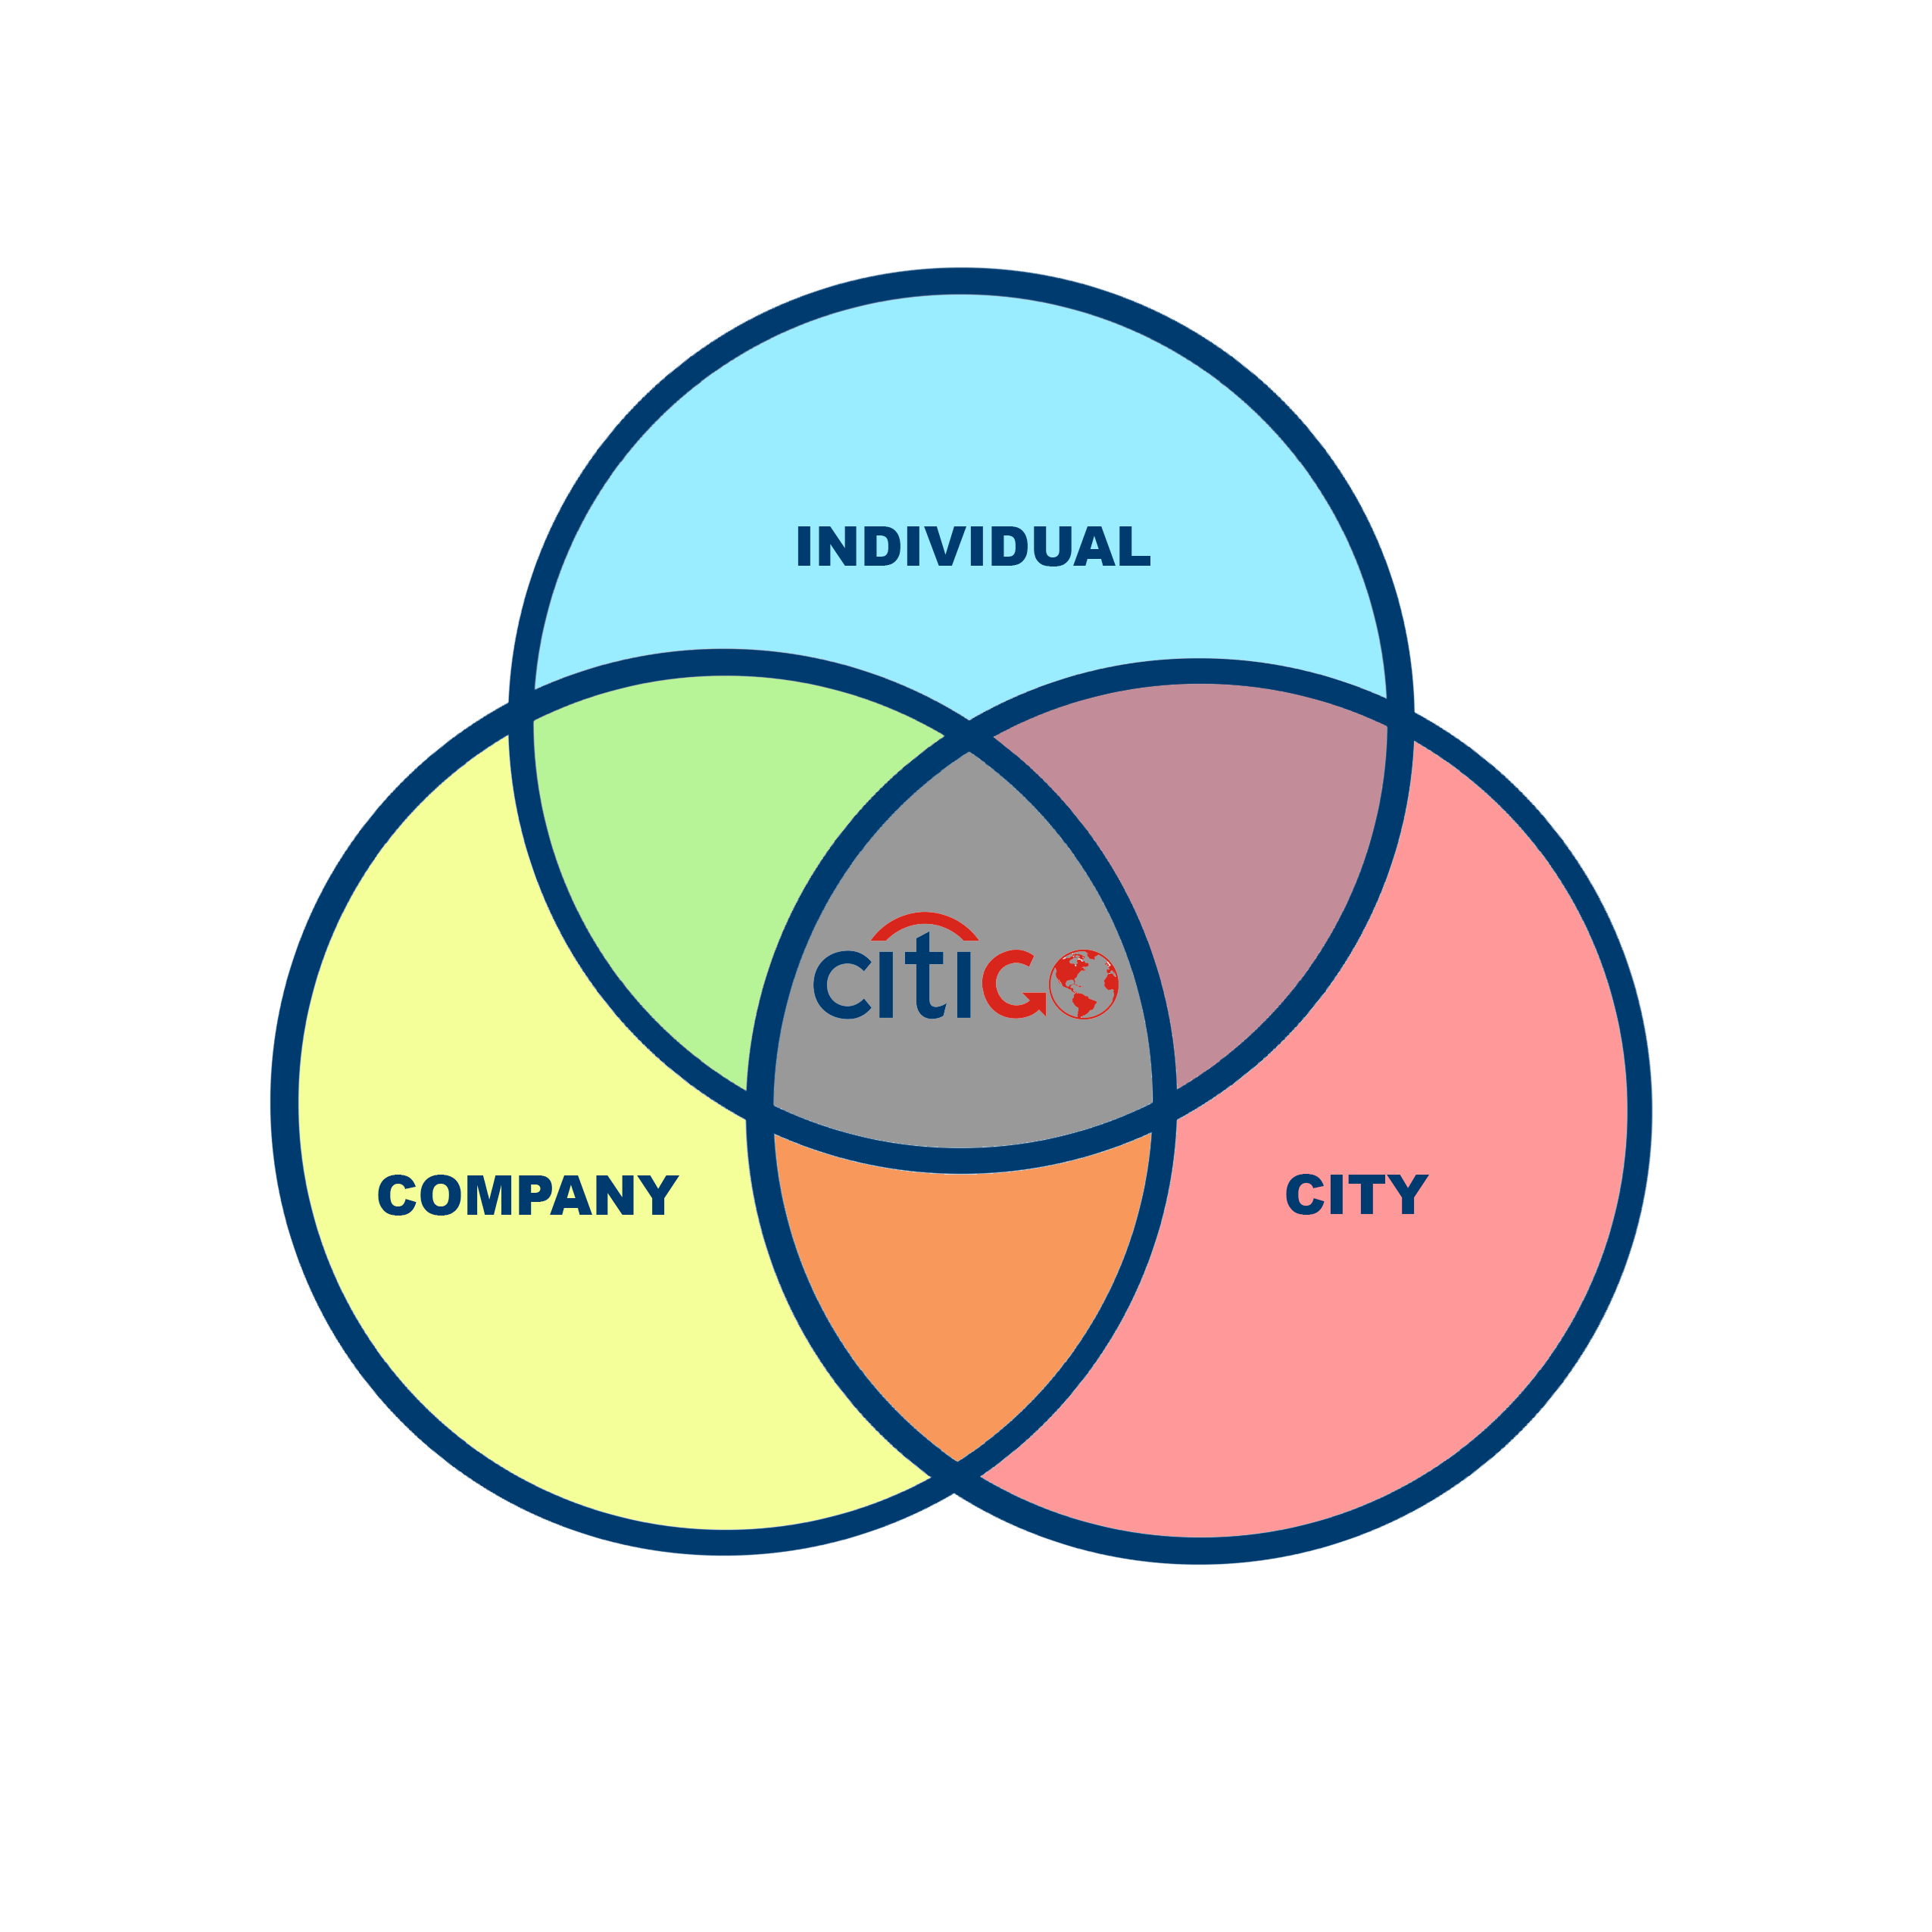
Home
Contents
Executive Summary
Vision
Pain Points
Solution
Product Mockup
Pros & Cons
Differentiation
Future Vision
Road Map
Digital Media & Marketing - ATP World Tour

Slide 7
Home
Contents
Executive Summary
Vision
Pain Points
Solution
Product Mockup
Pros & Cons
Differentiation
Future Vision
Road Map
Solution
Content Removed due to Confidentiality Reasons
Digital Media & Marketing - ATP World Tour

Slide 8
Home
Contents
Executive Summary
Vision
Pain Points
Solution
Product Mockup
Pros & Cons
Differentiation
Future Vision
Road Map
Product Mockup
Content Removed due to Confidentiality Reasons
Digital Media & Marketing - ATP World Tour

Slide 9


Home
Contents
Executive Summary
Vision
Pain Points
Solution
Product Mockup
Pros & Cons
Differentiation
Future Vision
Road Map
Pros & Cons
Advantages
More holistic system than current competitors
Real time update system
Potential for monetization
Spread of Citi brand name in consumer market
Valuable user data can be used to improve the system/further insights
People coming back because of community - long term sustainability
Long term social well being - better fit for users
Gaps
Data update and data quality challenges
High investment cost in technology - building algorithms & models
High maintenance cost and efforts
Digital Media & Marketing - ATP World Tour

Slide 10
Home
Contents
Executive Summary
Vision
Pain Points
Solution
Product Mockup
Pros & Cons
Differentiation
Future Vision
Road Map
Differentiation
Holistic transition platform
Active community
Links to different services;
- Loans
- Career counseling services
- Connections to recommended users
Digital Media & Marketing - ATP World Tour

Slide 11
Home
Contents
Executive Summary
Vision
Pain Points
Solution
Product Mockup
Pros & Cons
Differentiation
Future Vision
Road Map
Future Vision
Future Vision of the product
Partnerships with companies, schools, city government etc.
Offer future vision of the city for users/companies using VR/AR (collaborate with Google maps, architecture firms, and real estate companies that are already investing in these cities, what will the future look).
Digital Media & Marketing - ATP World Tour

Slide 12
Home
Contents
Executive Summary
Vision
Pain Points
Solution
Product Mockup
Pros & Cons
Differentiation
Future Vision
Road Map
Road Map (short-term)
6 month
Stabilize data structure, establish reliable data sources (but in the long term, we will work on improving data quality, accuracy etc.)
Scale the product (more locations, industries)
1 year
1 to 1 chat with city experts (create a virtual community)
Chat forums specific to each city
Monetization processes (housing/business loans offered through Citibank, chats with experts, relocation packages, advertising)
Develop customer base & reputation
Digital Media & Marketing - ATP World Tour

Slide 13


